Slide 1


Marathwada Mitra mandal’s
COLLEGE OF ENGINEERING
Karvenagar, Pune
An Autonomous Institute
Presentation
On
Travel-Planning Application (TravelMate)

Slide 2
Group Information
Sr.No | Prn No | Name of students
1 | B24IT1031 | Rajwardhan Bendre
2 | B24IT1040 | Vinit Patil
3 | B24IT1044 | Sarthak Patil
4 | B24IT1059 | Varad Rajboinwad

Slide 3
Introduction
Introduction
The purpose of the TravelMate App is to develop a user-friendly and intuitive digital platform that empowers users to seamlessly plan their trips. This includes choosing destinations, comparing transport and accommodation options, and receiving personalized travel recommendations. Designed with a strong focus on user experience (UX), the app aims to simplify trip planning through features like a smart chatbot, itinerary generation, and budget-based suggestions. The goal is to make travel planning accessible, efficient, and enjoyable for everyone—whether it's solo travelers, families, or groups of friends.
Scope
The scope of this project includes the design of a user-centric travel planning application that focuses on the following key features:
User Type: Individual travelers and small groups.
Core Features:
Destination search and trip inspiration and Booking options for flights and hotels
Basic itinerary planning
Smart Assistance: A simple chatbot that recommends plans based on user budget and preferences.
Trip Sharing: Allows users to share their travel plans with others.
Accessibility:
Mobile-friendly responsive design
Clean and intuitive interface for users of all experience levels

Slide 4
Objective
Help Users Take Control of Their Travel Plans Enable users to easily manage destinations, bookings, budgets, and itineraries in one place.
Make Trip Planning Effortless
Offer a simple, intuitive interface with smart suggestions and organized travel workflows.
Make Travel Tools Accessible to All Design the app for users of all backgrounds with user-friendly layouts and guided flows.
Provide Smart, Personalized Suggestions Use user input and preferences to recommend travel plans, accommodations, and activities.
Ensure Secure and Smooth Experience Across Devices Build a reliable, responsive app that works well on all devices with safe data handling.

Slide 5
Feature (Module Description)
User Management Secure sign-up and login, user profile setup, password recovery, and basic activity tracking for travelers.
Trip Planning & Booking Search and book transport (flights, trains, buses), choose hotels, set travel preferences, and plan trips within a budget
Smart Itinerary & Suggestions AI-powered travel assistant to generate personalized itineraries, suggest destinations, and recommend activities based on user inputs.
Sharing & Support Tools Trip sharing via link or app, in-app guidance, feedback form, and basic help desk or chatbot support.
Integration & Accessibility Map and weather API integration, mobile-friendly interface, language options, and basic accessibility for smooth usage across devices.

Slide 6
Functional and non-functional requirement
Functional Requirements :
User Management Simple registration/login, password recovery, and profile setup
Travel Booking Search and book transport and hotels with basic filters and budget options.
Reporting & Smart Planning AI-based itinerary suggestions tailored to user preferences.
Support & Feedback Basic chatbot support, travel tips, and feedback form.
Integrations & Accessibility Mobile-friendly design, map integration, and multi-language support.
Non-Functional Requirements (Shortened):
Performance & Reliability Fast responses (within 2 seconds), 99.9% uptime, and stable performance during high traffic.
Security End-to-end encryption, password protection, and basic data privacy measures.
Usability Clean, responsive UI with easy navigation and accessible features for all users.
Data Integrity & Backup Regular backups, smooth recovery, and alert system for maintenance.
Scalability Cloud-based design that supports growth and easy integration with maps, weather, or payment APIs.

Slide 7
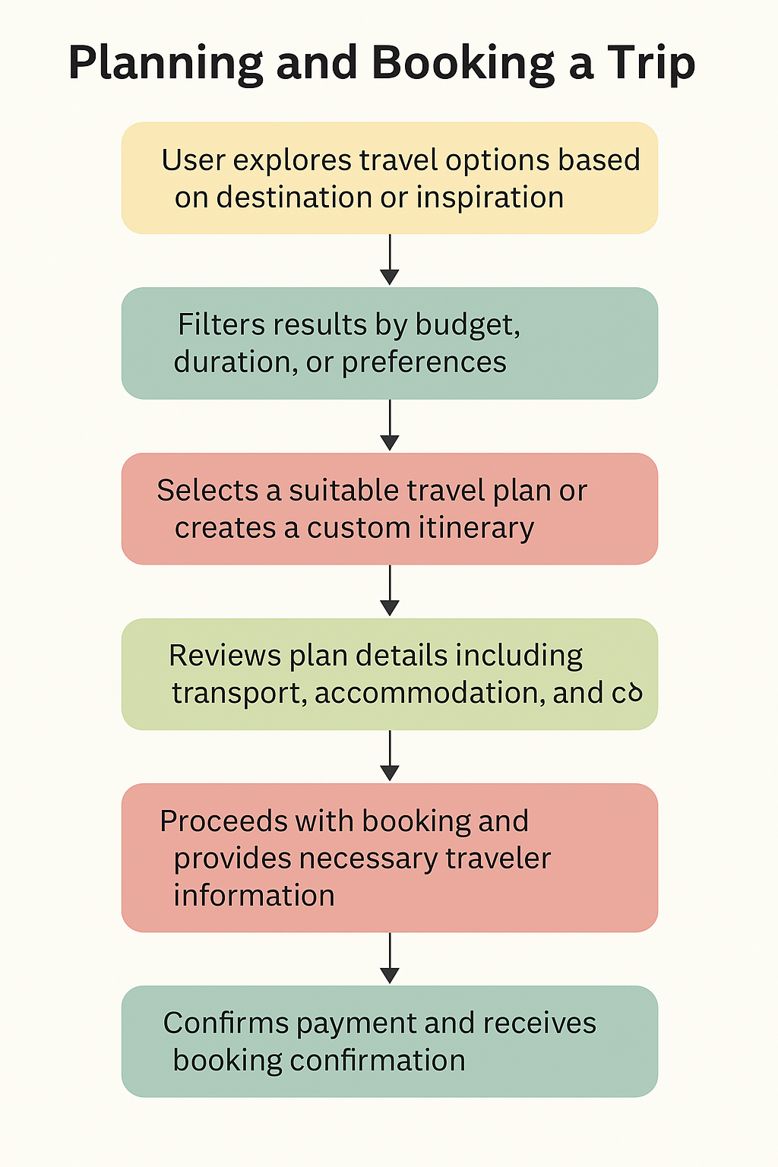
Task Flows Chart 1

Slide 8
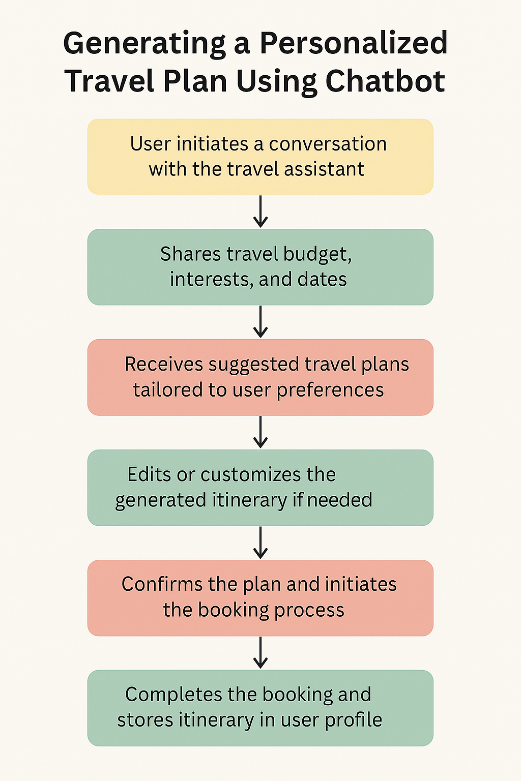
Task Flows Chart 2

Slide 9
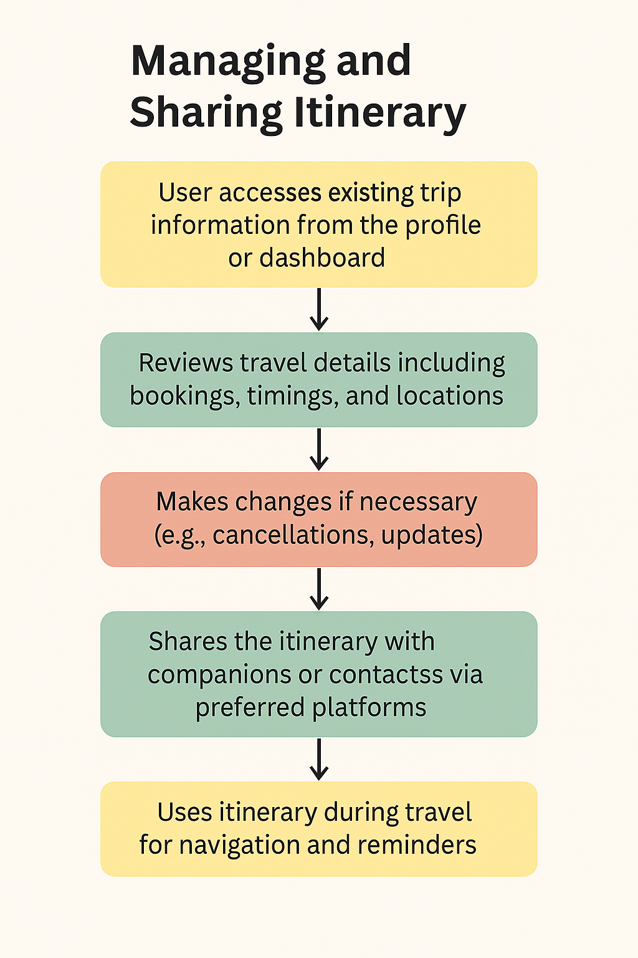
Task Flow Chart 3

Slide 10
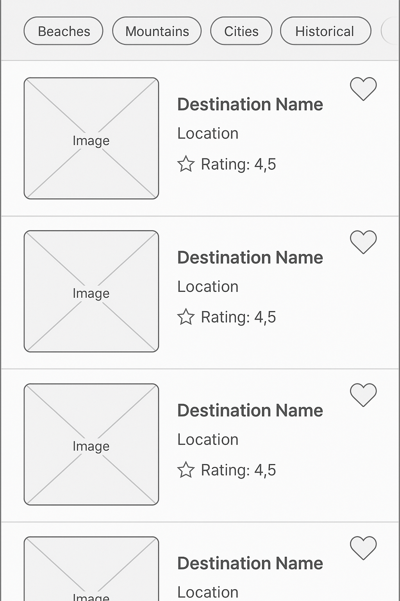
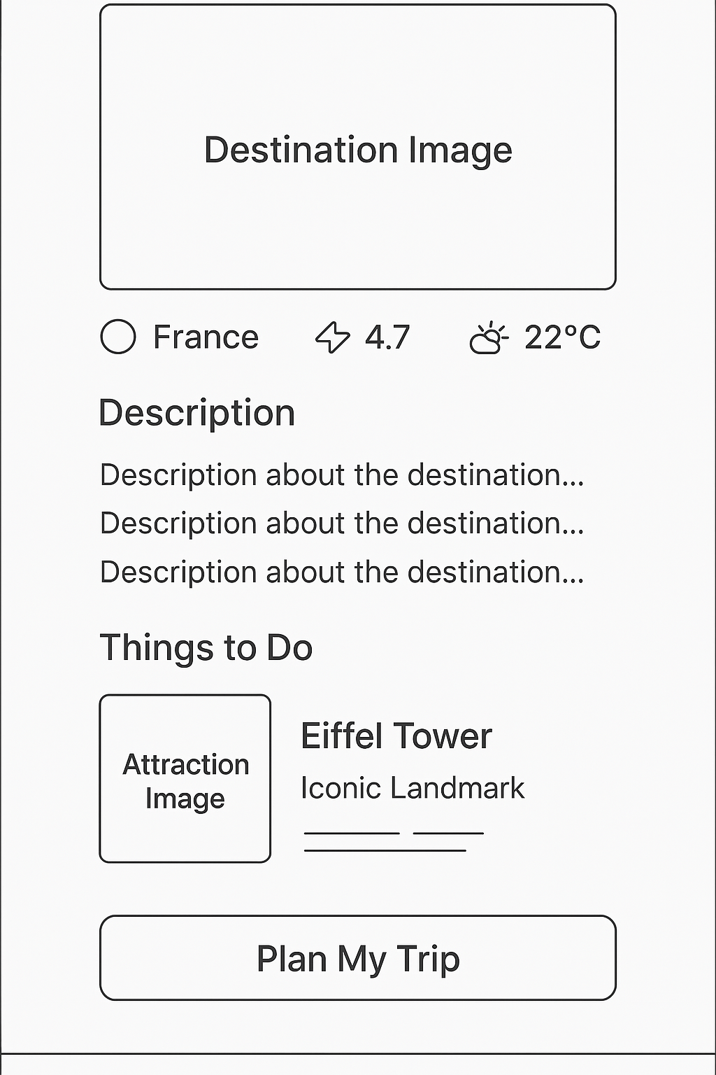
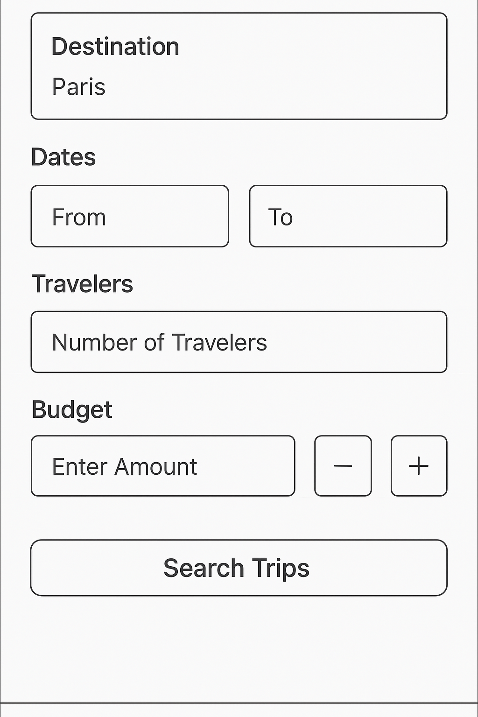
Low-Fidelity Wireframes

Slide 11
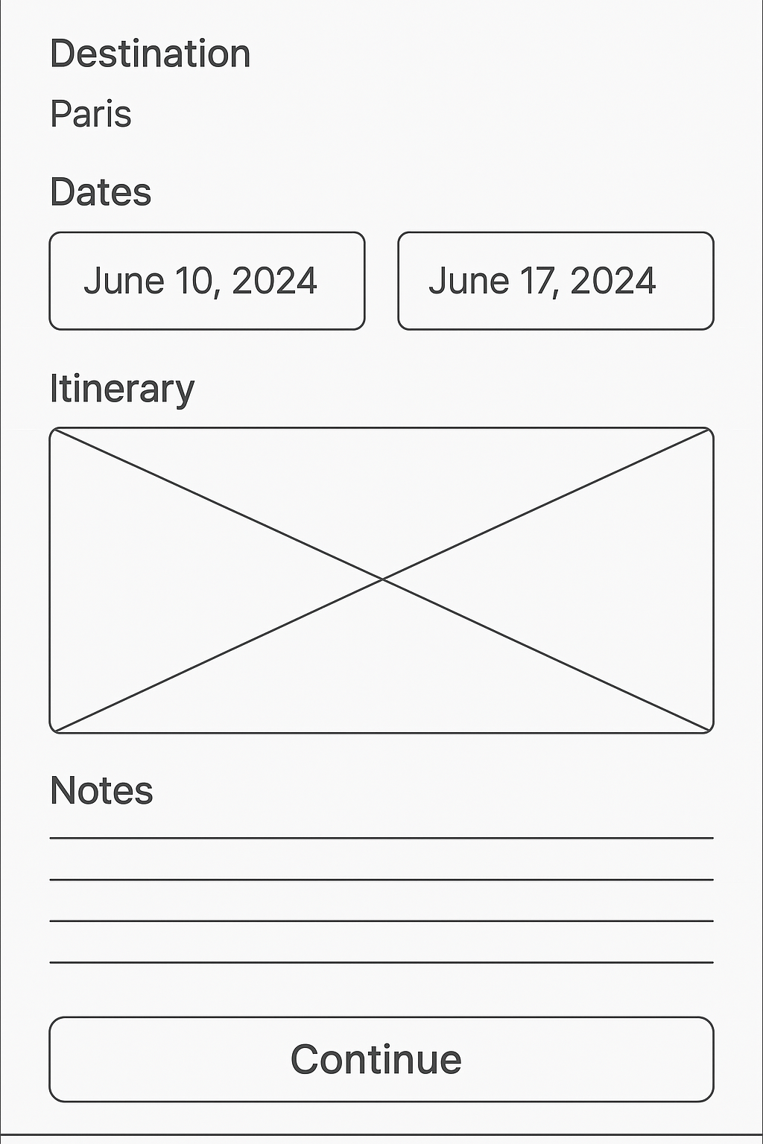
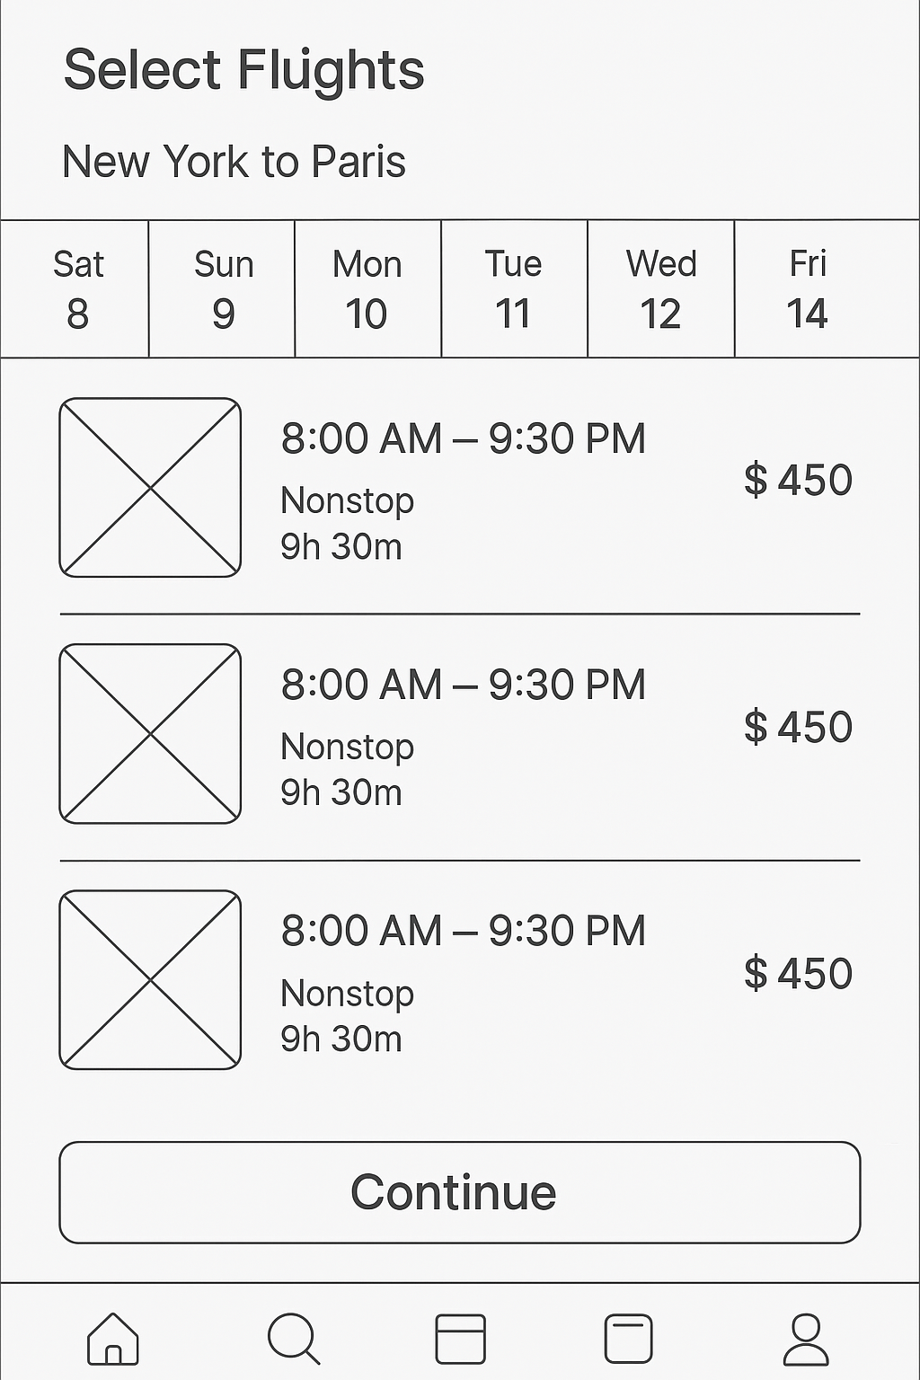
Low-Fidelity Wireframes
Flight

Slide 12
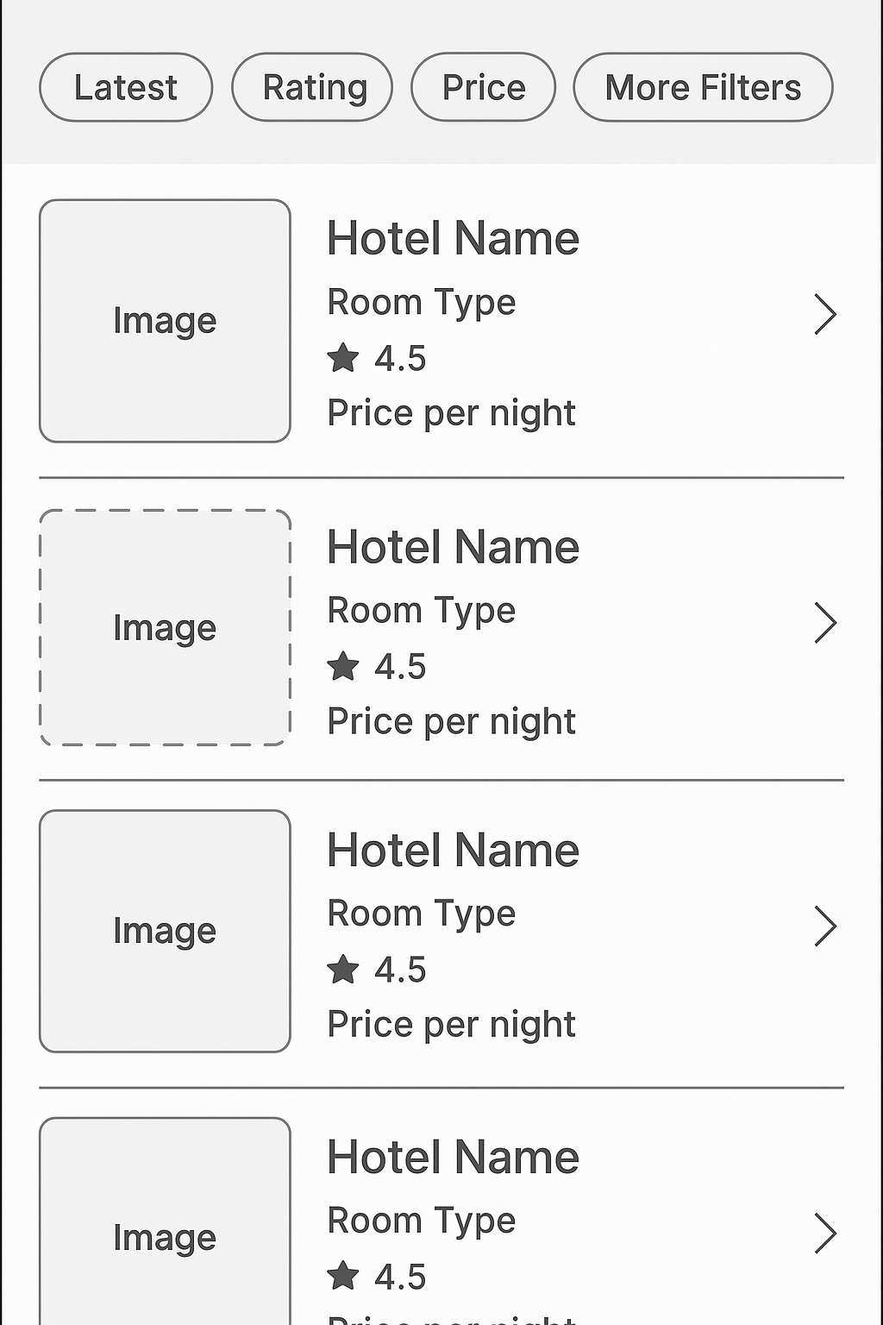
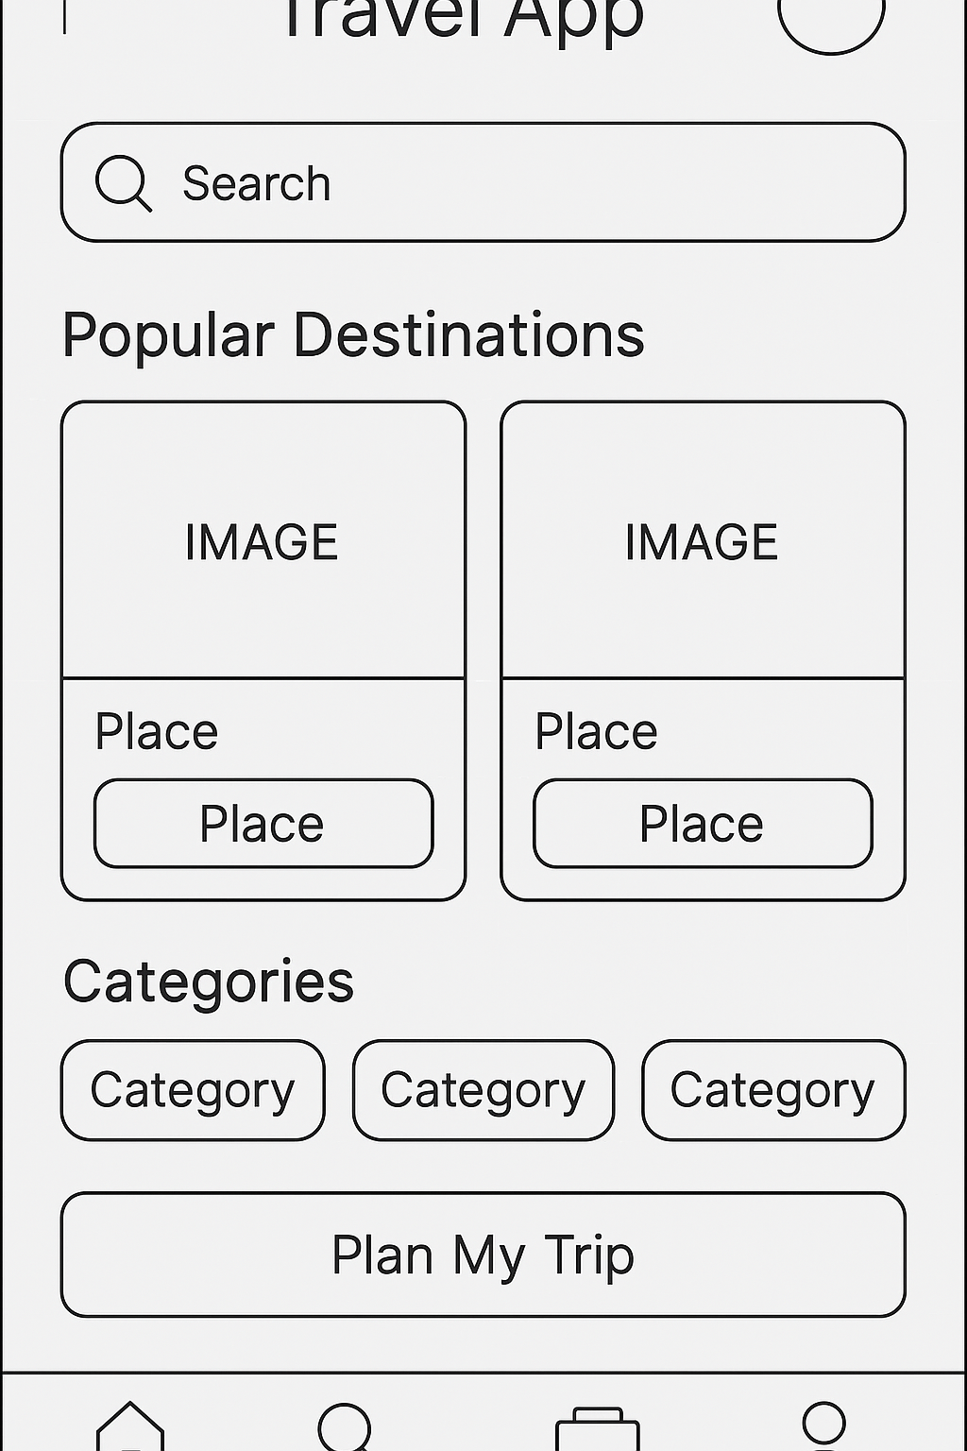
Low-Fidelity Wireframes

Slide 13
Link of Prototype
Link to the Interactive Prototype
Link of Project in Figma
Link to the GitHub Repository
GitHub Link
YouTube video Link
Video Link

